Slide 1
GET COMMIT-TED!
David Ayers
@iamagiantnerd
Principal Architect
Credera
“Programs must be written for people to read, and only incidentally for machines to execute.”
― Harold Abelson, Structure and Interpretation of Computer Programs
Notes:
Good Afternoon!
I’m going to start with a quote:
“Programs must be written for people to read, and only incidentally for machines to execute” – Harold Abelson
I couldn’t agree more; the code you write needs to be understandable. I have a corollary quote:

Slide 2
“Pull Requests & commits must be written for people to read, and only incidentally to fulfill the needs of a particular user story.”
― David Ayers, DevOpsDaysDFW 2018
Notes:
“Pull Requests & commits must be written for people to read, and only incidentally to fulfill the needs of a particular user story.”
This soon to be famous quote was said here, on this stage, for the first time ever! Let it be noted.

Slide 3

Notes:
In other words, the commits that you write tell the story *behind* the code.
If you're writing good code, *what* the code does should be evident.
But there is often crucial context about *why* the code is written a certain way that isn't captured when the code it being written.

Slide 4

Notes:
This meta context can help you understand the reasons particular patterns were followed, or why particular decisions were made.
Think of it this way -- the story you tell about your code can either be a love letter to your future self (or co-workers), or it can be hate mail.

Slide 5

Notes:
When you are looking back a year later, would you rather have a well thought out commit history, or giant unexplained commits with tons of changes and no rhyme or reason to why it was done?

Slide 6

Notes:
The rest of this talk assumes you are using git, and assumes you are using a Pull or Merge request workflow. If you aren't doing these two things, I highly recommend them!
First, the basics. Since good technologist are all about re-use, I found a great explanation already out there and I’m going to use it! Chris Beams layed out the 7 rules for great commit messages:

Slide 7
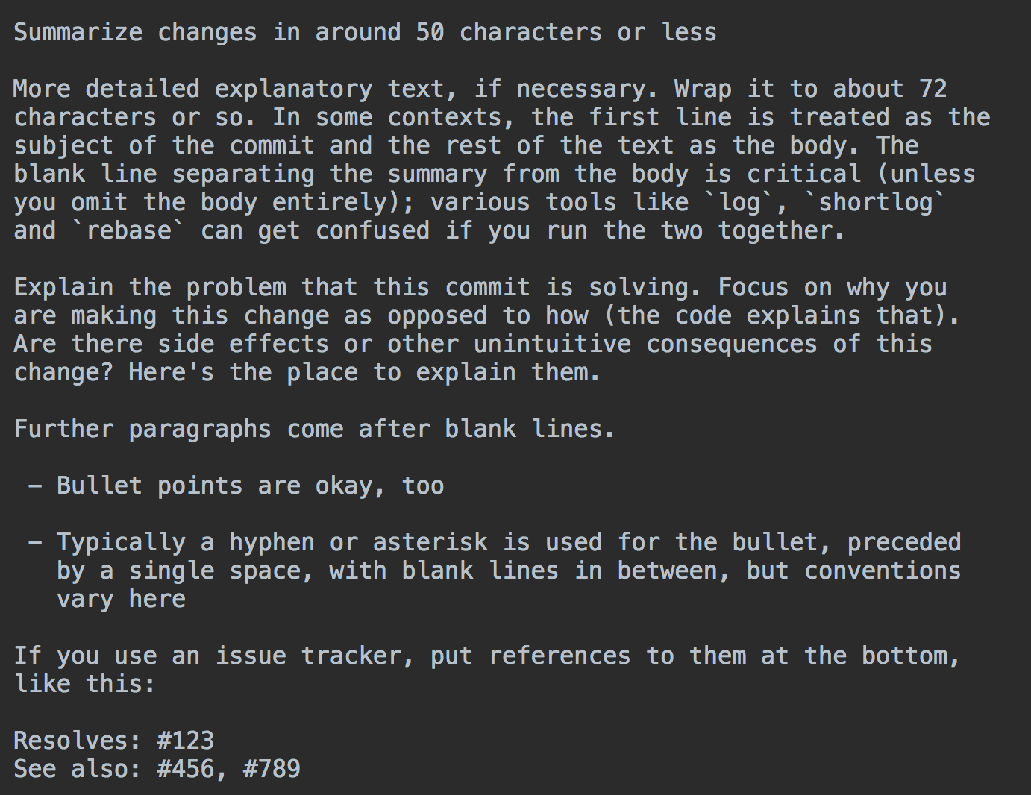
Separate subject line from body with a blank line
Limit the subject line to 50 characters
Capitalize the subject line
Do not end the subject line with a period
From: https://chris.beams.io/posts/git-commit/
Notes:
Separate subject from body with a blank line
Limit the subject line to 50 characters
Capitalize the subject line
Do not end the subject line with a period

Slide 8
Use the imperative mood in the subject line
Wrap the body at 72 characters
Use the body to explain what and why vs. how
From: https://chris.beams.io/posts/git-commit/
Notes:
Use the imperative mood in the subject line
Wrap the body at 72 characters
Use the body to explain what and why vs. how
I won't rehash all of this; go, read this post and start doing it!

Slide 9

Notes:
Just like programs should be written for people to read, commits should be written so that the code is easy to review. The commits should work together to tell a story -- each commit should be bite size chunk that allows a clear understanding of the changes that were made.

Slide 10

Notes:
And reading through the pull request should lead the reviewer through a logical series of steps that builds on top of each other, like bricks in a wall, to create an understanding of the changes as a whole; each commit should build on previous commits in a way that aids this understanding.

Slide 11
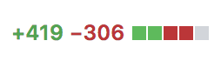
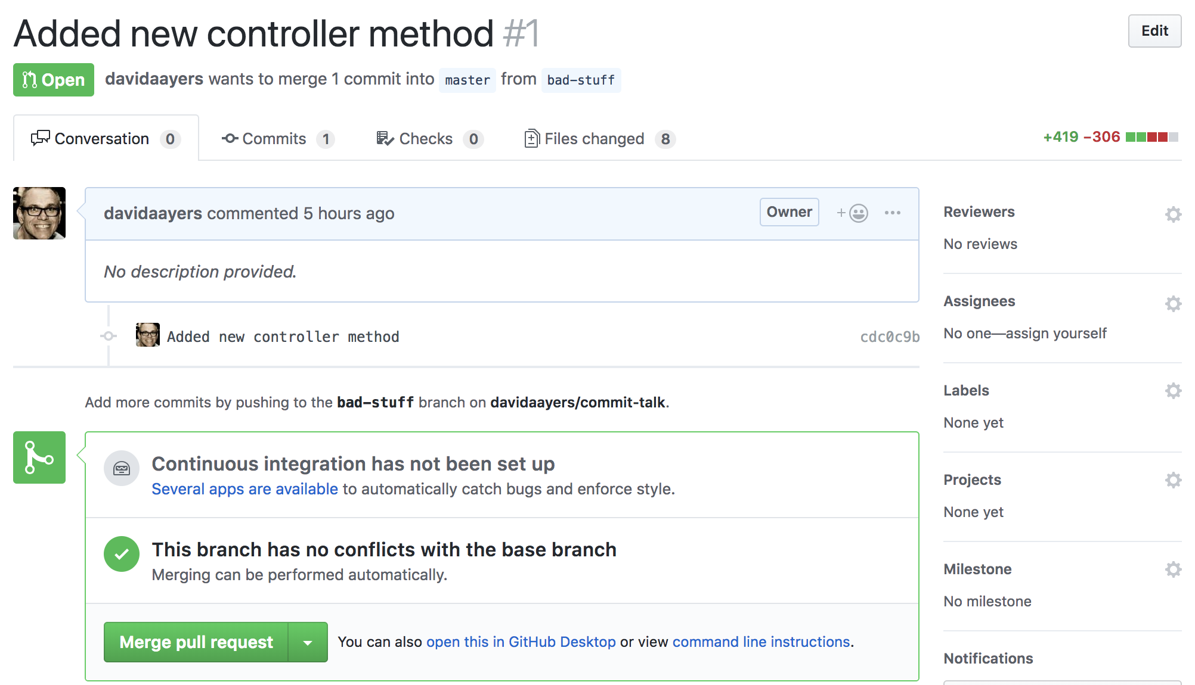
😱
Notes:
First , here's what not to do:
As you can see from this, the committer here added a new controller method. But it appears from the +419 -306 that there is a lot more to the story.

Slide 12
Notes:
<slide of a PR with a terrible series of commit>
And looking at the code under “Files changed” looks like almost every file was touched! It’s almost impossible to find the salient work that was done amongst all of the noise.

Slide 13
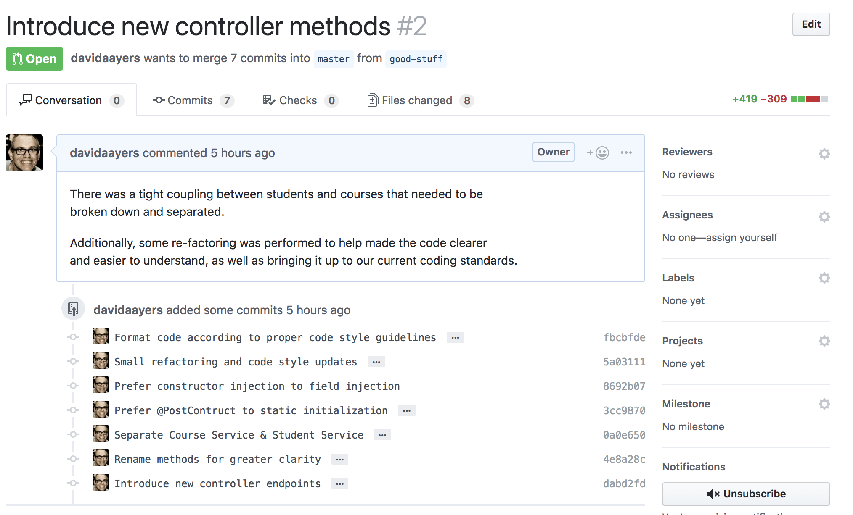
😆👍
Notes:
Here’s the same work done in a way that helps us understand what was done.
Even though the same amount of work has been done, there are now a series of logic commits that help the reviewer (and your future self!) understand exactly what has been done.

Slide 14
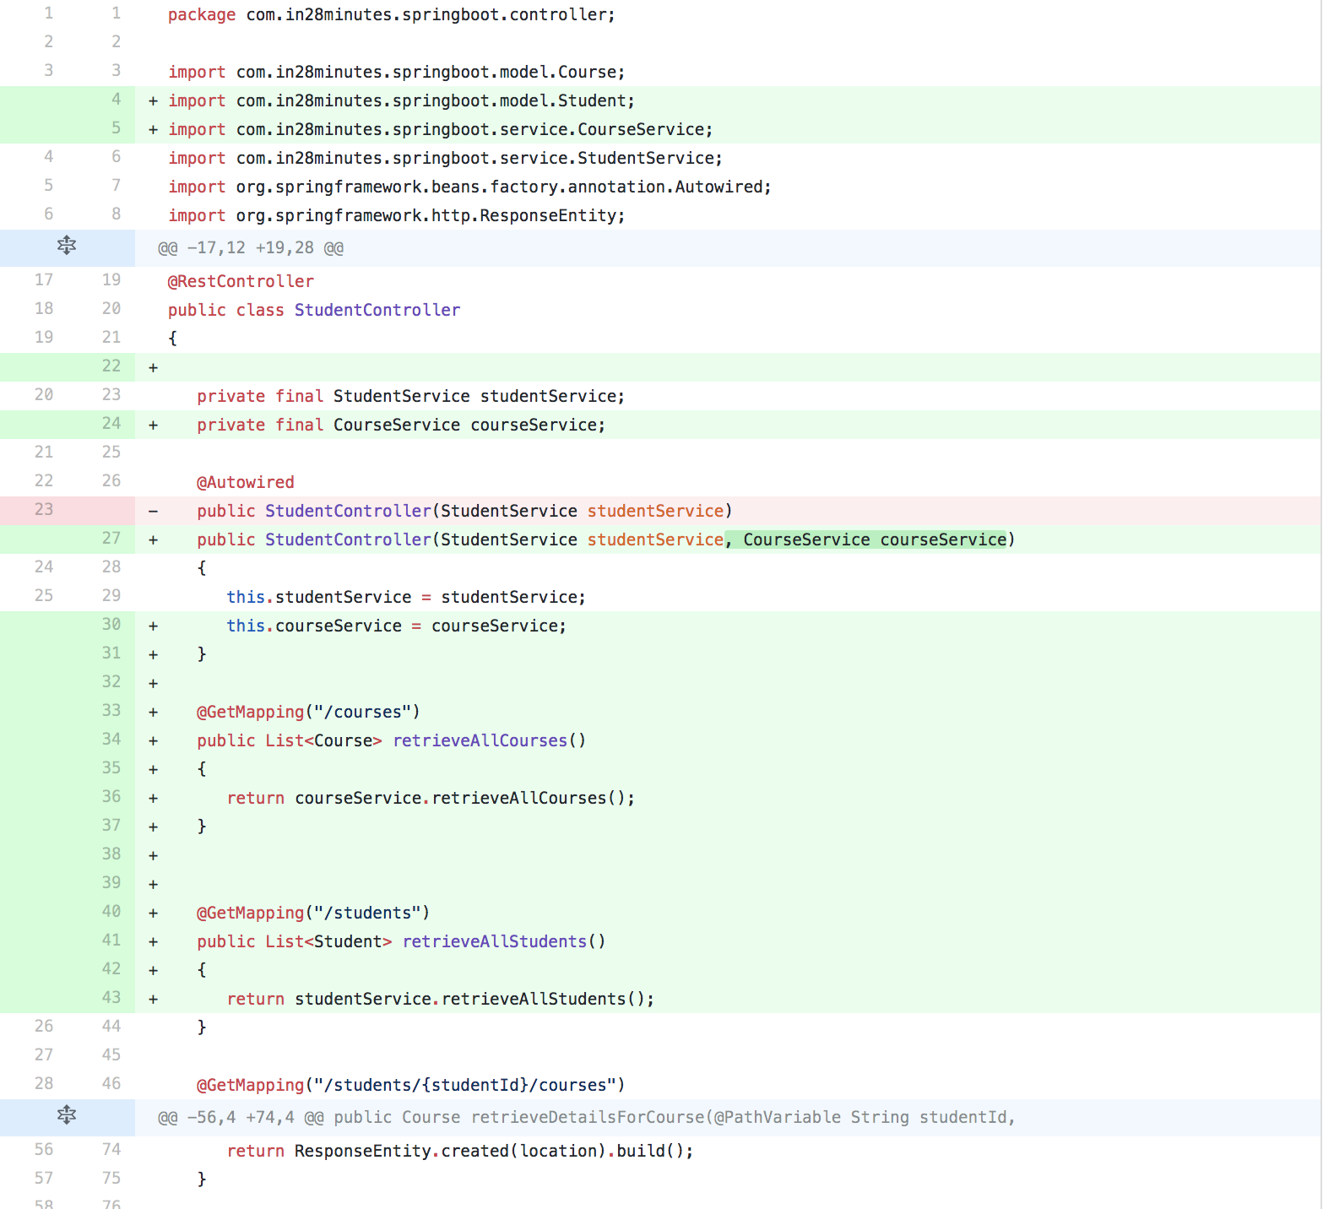
Notes:
The reformatting & refactoring was done in a way that can easily understand the progression, and in the final commit where the “actual” work was done, it’s easy to see the additional controller methods without all the noise.

Slide 15
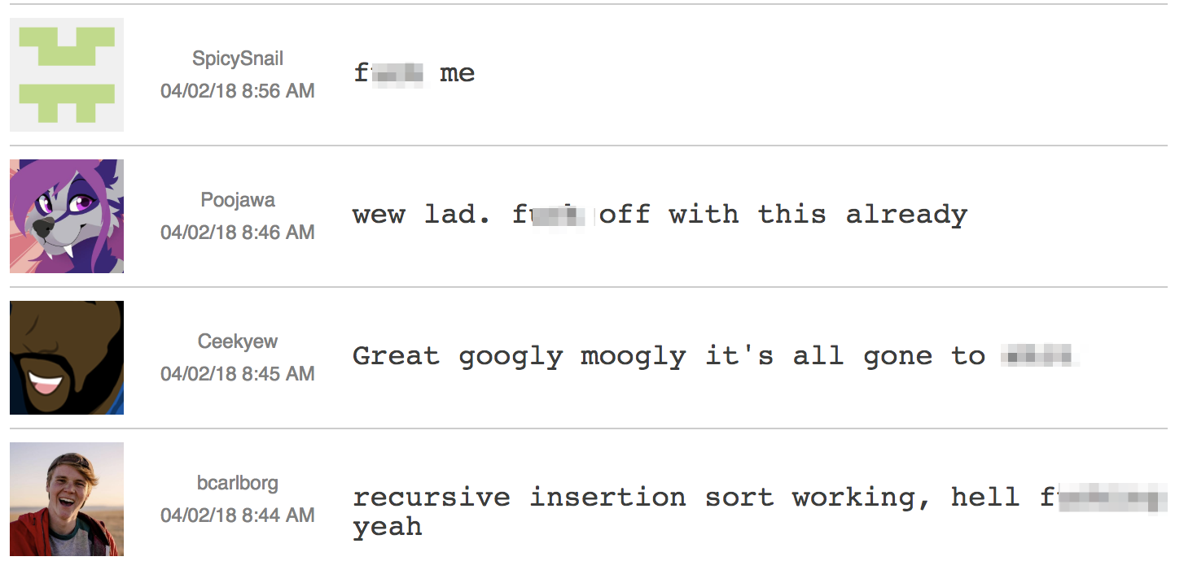
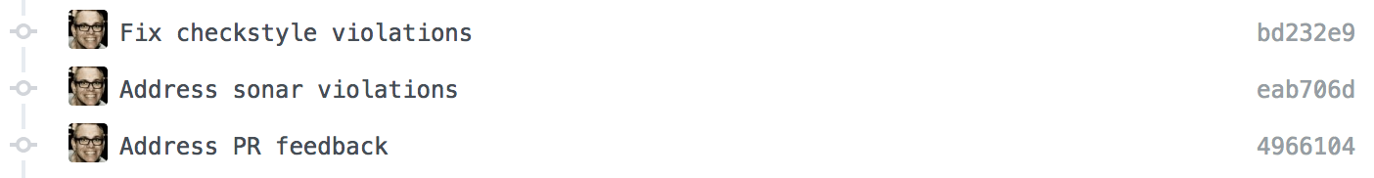
Funny Commits – w/expletives!
http://www.commitlogsfromlastnight.com
Violations galore!
Emojis!
Notes:
In addition to just unstructured commits, there are some common anti-patterns I have seen:
Funny/crude commits
“Sonar/Linting/PR Feedback Cleanup”
“Emojis"

Slide 16

Notes:
Accomplishing this level of clarity with your commit messages and pull requests requires effort and disciple. Using git provides tools to help, like interactive rebase. Rebasing scares some people, but like all powerful tools, it should be learned rather than shunned.

Slide 17

Notes:
Let's say you're half way through working on some problem, and so far you have crafted great commit messages that tell a clear and precise story. But now you've stumbled upon a refactoring that you'd like to do, but that work probably would have made more sense if you had done it first. Thanks to the magic of interactive rebasing, you can make it look like you did this work first.

Slide 18

Notes:
I've talked a lot about writing commits to be reviewed, but the end result of thinking this way also helps you -- it's how you write that love letter to yourself. This kind of care and attention to how you craft your commit messages pays dividends in many ways.

Slide 19

Notes:
I think there's another benefit that I haven't even talked about yet -- by training yourself to think like this, and craft your commit messages to tell the story you're trying to tell, it actually helps you think about the work you're going to do in logical chunks

Slide 20
Thank You!
David Ayers
@iamagiantnerd
Principal Architect
Credera
Presentation & Photo credits:
https://github.com/davidaayers/commit-talk
Notes:
which can become self reinforcing; the more you write commits this way, the better structured your thinking becomes as you approach how you solve problems.
Thank you for your time! I hope you will start using some of these techniques right away!

